Slide 1
STATASTICAL MACHINE LEARNING
REVIEW-1

Slide 2
INTRODUCTION
*There are various parametres that we need to take into consideration in
order to calculate.
*we have choosen linear regression to predict batsman strike rate
according to the matches,runs,average and economy.
*Because in linear regression string values cannot be find.
*In our dataset we are going to explain the features of bastman with
strike rate.
*A measure of the relation between the mean value of one variable (output) and corresponding,
Values of other variables is called regression.

Slide 3
This dataset provides a name of the team,players along with matches,runs,highest and average of a batsman.

Slide 4
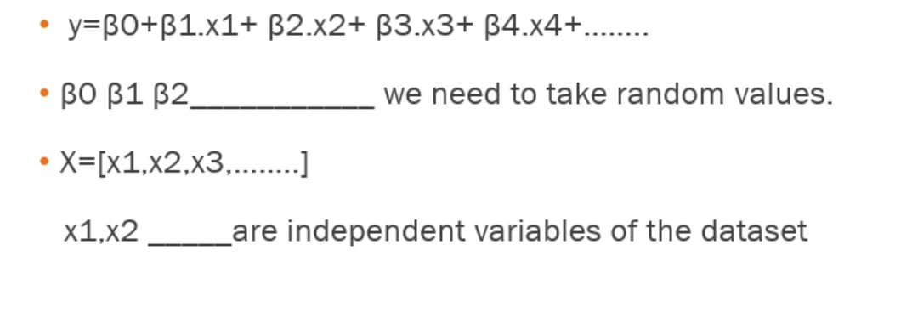
LINEAR REGRESSION MODEL

Slide 5
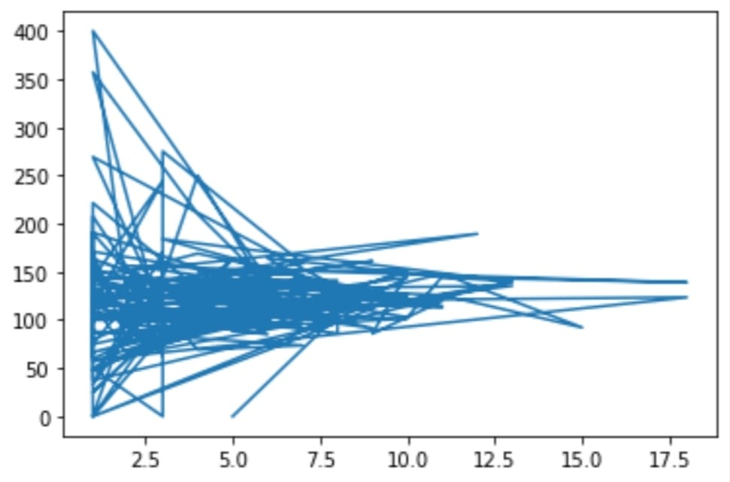
x1=d[‘Matches’] y=d[‘Strike_rate’]
[<matplotlib.lines.Line2D at 0x7fce06b9e810

Slide 6
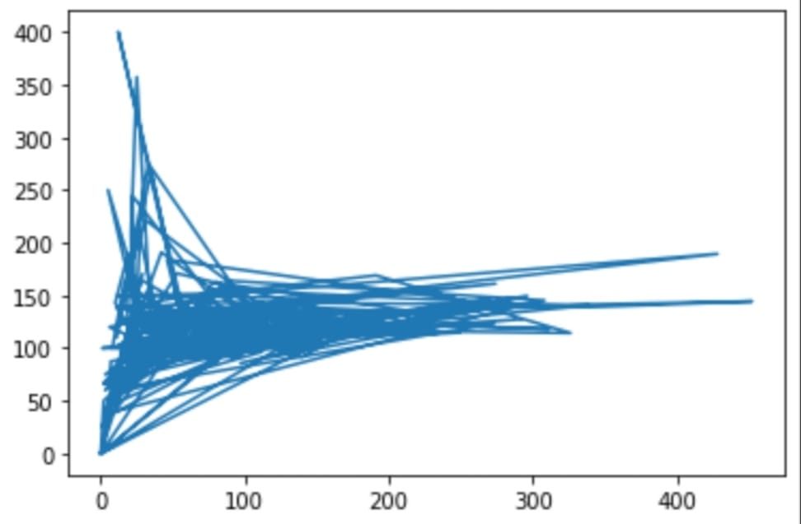
x2=[‘Runs’]
[<matplotlib.lines.Line2D at 0x7fce06b9e810

Slide 7
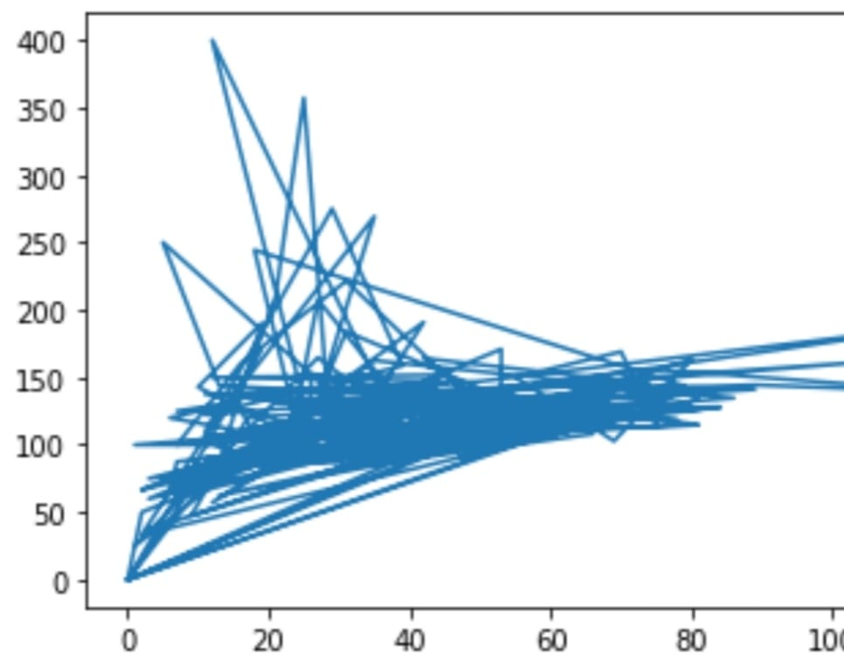
x3=[‘Highest’]
[<matplotlib.lines.Line2D at 0x7fce06b9e810

Slide 8
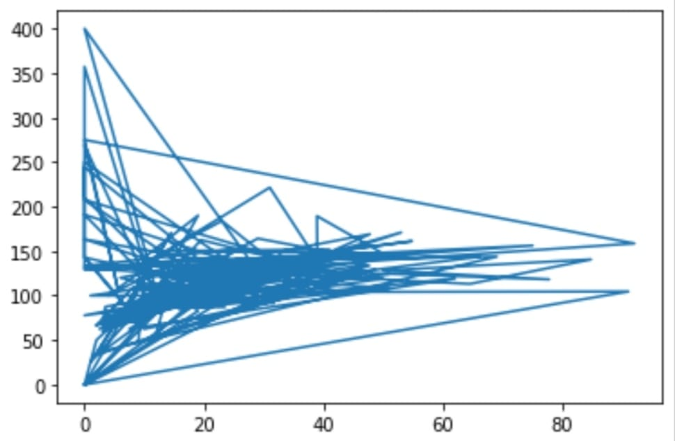
x4=[‘Average’]
[<matplotlib.lines.Line2D at 0x7fce06b9e810

Slide 9
CONCLUSION
*This dataset comes under parametric method.
*In parametric method it comes under supervised machine learning.
*In this data set y values are quantitative data.
*So,it is Regression.
*We use linear regression and mean square error method instead of KNN because in KNN dimensions(x) increases distance or calculation also increases .so,the performance decreases.
*That is why we use linear regression.

Slide 10
THANK YOU!

